Slide 1
Dayona Car Dealership Summary Slides
May 1, 2021

Slide 2
Problem Statement
Dayona Car Dealership’s goal is to decide selling new cars to which customers by developing a data-driven business strategy.
CONTEXT: Current there are 5 groups that divided by the model.
Which model would be appropriate given Dayona Car Dealership’s features relative to sell cars?
SCOPE: Customer calibration based on provided features of selling car data

Slide 3
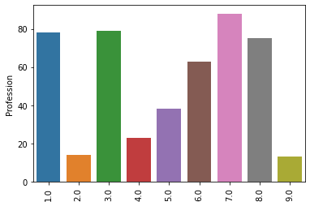
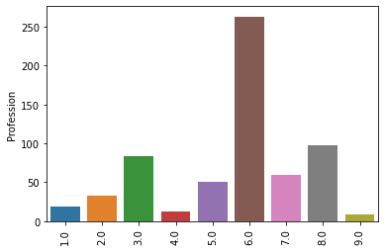
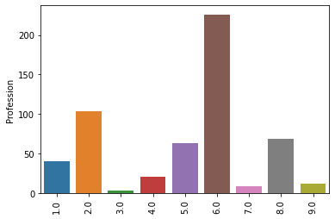
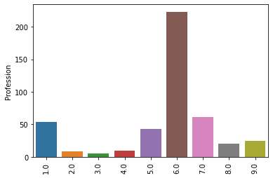
Modeling results
Engineer = 1, Healthcare = 2, Executive = 3, Marketing = 4, Doctor = 5, Artist = 6, Lawyer = 7, Entertaiment = 8, Homemaker = 9
Artist Profession takes in majority of the groups.
Car dealership can selling more design appealing cars then power cars.
Indicates that Artist customers may be willing to buy more cars then other Profession features

Slide 4
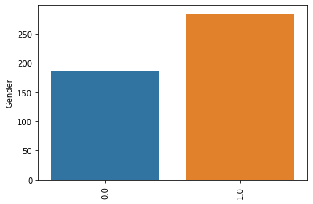
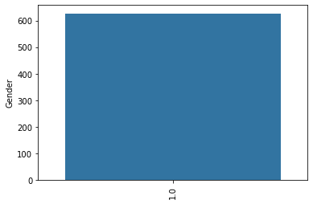
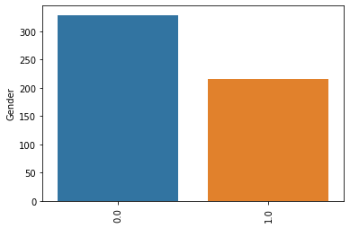
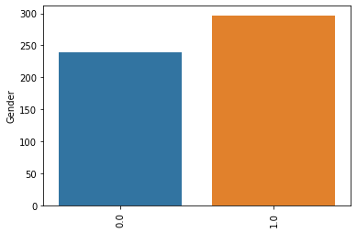
Modeling results
Male = 0, Female = 1
Car dealership can sell more cars for male then females but there is not much difference.
Indicates that Male customers may be willing to buy more cars then Female customer.

Slide 5
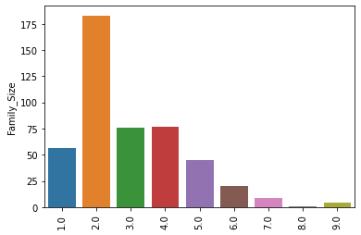
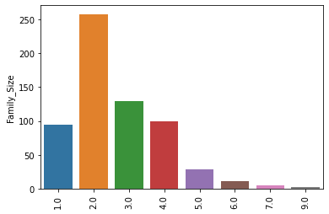
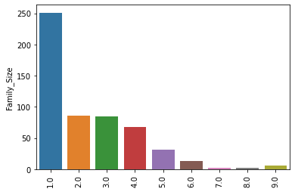
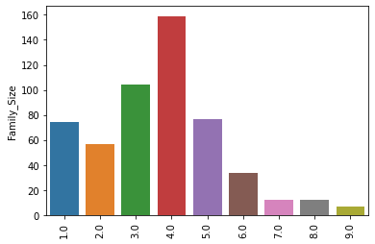
Modeling results
Looking for the family size feature, car dealership can sell more sedan cars then SUV or hatchback type cars.
Indicates that Family size of 2 customers may be willing to buy more cars then other size of family customer.

